Slide 1
My Plate at Home Health Activity #1
By: Mr. Maness

Slide 2
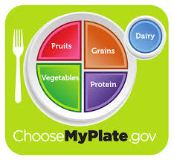
How to Plan Healthy Meals using MyPlate
https://www.youtube.com/watch?v=-J1hmmy1OB4

Slide 3
What Is MyPLate?
Latest dietary methods to promote healthy eating habits
ChooseMyPlate.gov lists the 5 food groups needed to provided the necessary building blocks for healthy eating
Fruits, Vegetables, Grains, Proteins, and Low-fat Dairy

Slide 4
Correct Portions of Food
Fruits and vegetables should account for half of your plate but there should be a little more vegetables than fruits
Grains should represent a quarter of the plate
Proteins should account for the final quarter of the plate
The smallest portion to accompany the others is a side of dairy

Slide 5
Correct Portions of Food

Slide 6
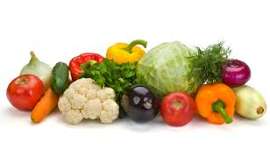
Vegetables
How do I choose what vegetables to eat?
Boost variety and use as many colors as possible
Vegetables provide vital nutrients for the body when eaten raw or lightly steamed
Examples- Broccoli, Bell Peppers, Spinach, Squash, Lettuce, Eggplant, etc.

Slide 7
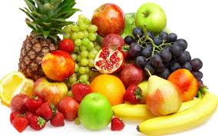
Fruits
Also boost variety and diversify color
Use in fruit salad or to sweeten up an entree
Raspberries, blueberries, and strawberries contain antioxidants which help stop heart disease and some types of cancer

Slide 8
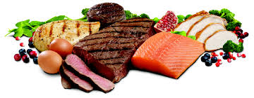
Proteins
Choose lean or low-fat choices such as chicken, fish, and other seafood to decrease the intake of cholesterol and saturated fats
Examples- Meat, Seafood, Beans, Soy, Eggs, Poultry, Nuts, and Seeds

Slide 9
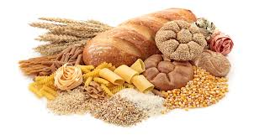
Grains
Supply complex carbohydrates, fiber, little fat
Examples- Bread, Cereal, Pasta, Oatmeal, Wheat, Rice, Quinoa, Millet, Rolled Oats
Try to eat whole grains not refined grains

Slide 10
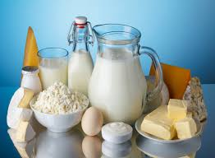
Dairy
Examples of Good Dairy- Milk, Cheese, Yogurt, Soy Milk
Examples of BAD Dairy- Butter, Cream, Cream Cheese

Slide 11
Student Create Plate Activity
Divide the paper plate into appropriate size portions for grains, vegetables, fruits, and proteins. Demonstrate which portions on the plate should be bigger than others.
Draw, color, and label pictures of foods you believe belong in the correct groups.
On the back of the plate, write examples of dairy items.

Slide 12
Student Create Plate Activity Example

